Slide 1
Introduction to TypeScript
Axle Barr

Slide 2
Introduction to TypeScript
What is TypeScript?
Developed by Microsoft and released in October 2012
Superset of JavaScript
Known for imposing strict typing on JavaScript
All TS code transpiles into JS code for the browser
ECMAScript support for TypeScript was formalized in 2015
Version 4.6 is now available
typescriptlang.org is the main source of documentation for TS
Origins of TypeScript

Slide 3
Introduction to TypeScript
Features
Interfaces
Namespaces
Generics
Abstract classes
Data modifiers
Decorators*
Readonly keyword
Type utils
Optionals
Function overloading
A few features of TypeScript
Notes:
Utility types can do transformation of one type into another. Eg partial types can make properties of the original type optional.

Slide 4
Advantages of using TypeScript
With a good IDE you can capture certain errors at compile time before they reach run time level
Support for static typing (strong typing)
TypeScript, once trans-piled down to JS can runs on any browser or JavaScript engine like NodeJS
Using a good IDE, the developer can have IntelliSense with TypeScript
Namespaces if used properly can be a great tool for modular development
A few features of TypeScript

Slide 5
Introduction to TypeScript
interface Employee {
name: string;
salary: number;
}
const axle: Employee = {
name: "Axle",
salary: 0,
}
A simple example
The object axle is of type Employee, defined above
Notes:
". In this example axle is of the Employee type.

Slide 6
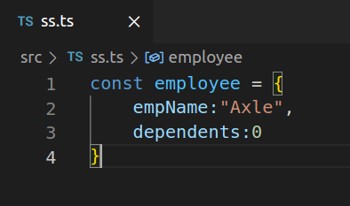
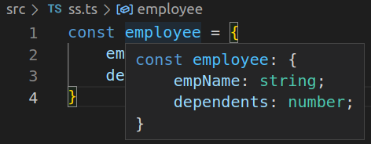
Inference in TS
A JavaScript Object
Using VSCode TS can infer details about a variable
TypeScript inference

Slide 7
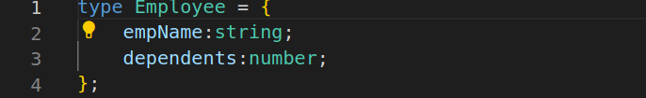
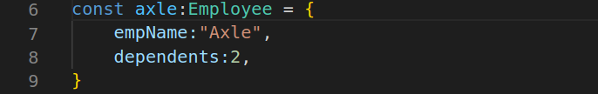
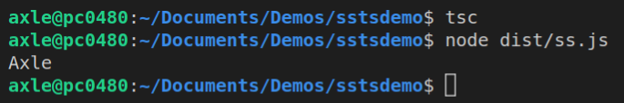
The Object Type
Object types are used like in other programming languages

Slide 8
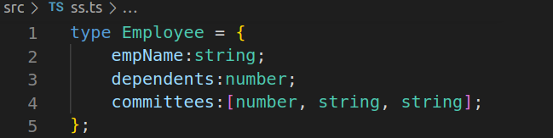
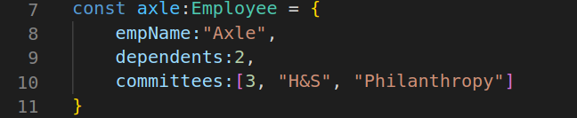
The Tuple
Potential problem

Slide 9
The Union
type someValue = string | number;
const someFunction = function (aParameter: someValue) {
console.log(aParameter);
};
//
someFunction('T-Shirt');
someFunction(10.99);
TS can define a mixed primitive type

Slide 10
The Union
type someValue = string | number;
const someFunction = function (aParameter: someValue) { aParameter = aParameter * 1.10;
console.log(aParameter);
};
//
someFunction('T-Shirt');
someFunction(10.99);
Arithmetic operation on a string?

Slide 11
The Union
type someValue = string | number;
const someFunction = function (aParameter: someValue) {
if ( typeof aParameter === 'number’ )
aParameter = aParameter * 1.10;
console.log(aParameter);
};
//
someFunction('T-Shirt');
someFunction(10.99);
This will compile

Slide 12
function irCalculator (p:number, r:number) {
return p * r;
};
//
let investment = irCalculator(1000, 0.10);
console.log("Interest is " + investment);

Slide 13
TypeScript Types
There are three categories of types:
Primitive (built-in types based on JavaScript types)
User-defined types (basically objects)
Any type
Others are unknown, tuple, array, union, interface and null
The type system in TypeScript

Slide 14
TypeScript Type Examples
let firstName:string = "John";
let quantity:number = 9;
let price:number = 26.99;
let total = quantity * price;
//printout
console.log("name " + firstName) ;
console.log("price " + price) ;
console.log("quantity " + quantity) ;
console.log("total: " + total);
The type system in TypeScript

Slide 15
TypeScript typeof Operator
let firstName:string = "John"; let quantity:number = 9; let price:number = 26.99; let total = quantity * price; console.log("name " + firstName); console.log(typeof firstName);//prints string console.log("price " + price); console.log("quantity " + quantity); console.log("total: " + total
typeof exists in TS also

Slide 16
TypeScript any Type
let firstName : any = "John";
firstName = 10;
console.log(firstName);//prints 10
The any type in TypeScript

Slide 17
TypeScript Types and Functions
function getTaxedPrice(price: number) {
const TAX : number = 1.10;
return price * TAX;
}
//
let total = getTaxedPrice(100);
console.log(total); //prints 110.00
Passing types to functions

Slide 18
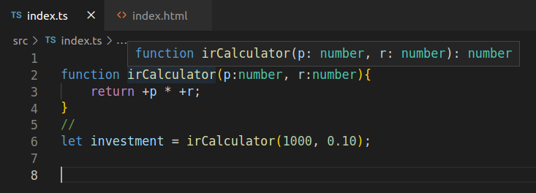
A note on function return types
Instead of: function irCalculator(p:number, r:number) : number {

Slide 19
TS understands the void type

Slide 20
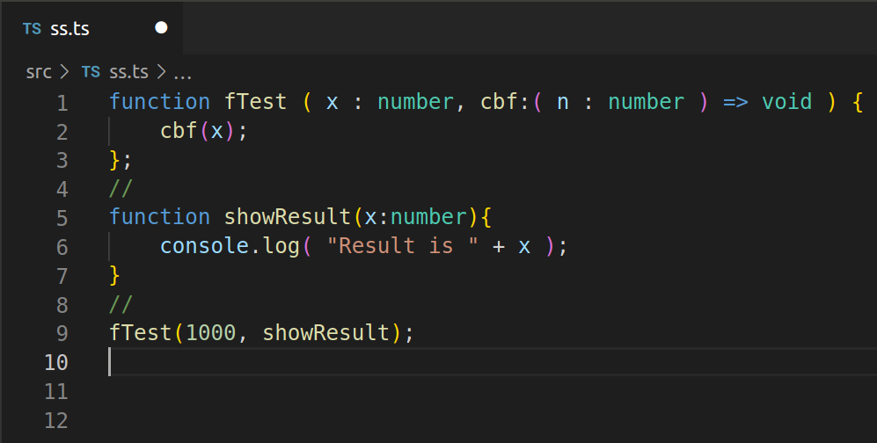
Function Types
A function can be passed into another function …delegates

Slide 21
The any Type
A variable of type any can be assigned with any of the other types including objects:
let myAnyVar: any = 0;
console.log(myAnyVar); //prints 0
myAnyVar = '0.55’;
console.log(myAnyVar); //prints 0.55
myAnyVar = false;
console.log(myAnyVar); //prints false
The any type does not provide type checking and should be avoided

Slide 22
The unknown Type
A variable of type unknown can be assigned with anything, just like type any:
let myAnyVar: any = 0;
console.log(myAnyVar); //prints 0
myAnyVar = '0.55’;
console.log(myAnyVar); //prints 0.55
myAnyVar = false;
console.log(myAnyVar); //prints false
The unknown works similar to any

Slide 23
unknown vs any Types
let myAnyVar: unknown = “Hello”;
console.log(myAnyVar);
myAnyVar = '0.55';
console.log(myAnyVar);
First the unknown type
We know this code works
Notes:
From: https://dmitripavlutin.com/typescript-unknown-vs-any/
You can assign anything to unknown type but you have to do a type check or type assertion to operate on unknown You can assign anything to any type and you can perform any operation on any

Slide 24
unknown vs any Types
let myAnyVar: unknown = “Hello”;
console.log(myAnyVar);
myAnyVar = '0.55';
console.log(myAnyVar); let iRate = 10.5;
First the unknown type
Now we add a new variable to the program of the number type

Slide 25
unknown vs any Types
let myAnyVar: unknown = “Hello”;
console.log(myAnyVar);
myAnyVar = '0.55';
console.log(myAnyVar); let iRate = 10.5; iRate=myAnyVar;
First the unknown type
We immediately get a syntax error if we try to assign an unknown to a regular variable
Notes:
Always use the unknown where possible as it performs checking in the editor rather than at runtime.

Slide 26
unknown vs any Types
let myAnyVar: any = “Hello”;
console.log(myAnyVar);
myAnyVar = '0.55';
console.log(myAnyVar); let iRate = 10.5; iRate=myAnyVar;
The any type
However, if myAnyVar was of type any, the error check will pass

Slide 27
never Types
In TypeScript, the never type is represented by a value that never occur or returns. If a type in the full sense of the word defines values of that type, then the never type will be an empty set.
The never type occurs when:
An error is thrown
Infinite loop is detected
The never type
Notes:
In TypeScript, never is an empty set of values.

Slide 28
never Types
function errChecker(message: string): never {
throw new Error(message);
}
function errChecker() {
return error(“An error occured");
}
function endlessLoop(): never {
while (true) {}
}
A function that returns the never type, must not return anything
The never type
This function’s return will be inferred as never
This function’s return is also never, no other executable lines are accessible by the compiler
Notes:
Graphics:
There are three functions here and there are three messages. The first message is already shown and has to appear on the first click after the slide is loaded.
On next click, the line on the callout should point to the second function and insert this text for the callout box: This function’s return will be inferred as never.
On next click, the line on the callout should point to the third function and insert this text for the callout box: This function’s return is also never, no other executable lines are accessible by the compiler. Note, the callout box itself can be moved downwards for this third point.
In each case the line on the callout must point to the specific function.

Slide 29
Type Casting
let myNum: any = 2;
let myRealNum = +myNum;
let myRealNum = <number>+myNum;
let myRealNum = +myNum as number;
console.log(typeof myRealNum);
Three ways to typecast
Type casting is heavily used when working with the DOM
Notes:
Graphics: on slide start only three lines are visible, the first, second and the last line
On next click, the first line is hidden and the second line is revealed
On next click, the first and second lines are hidden and the third line is revealed
There must be only 3 lines visible each time.
On next click the box with the note appears

Slide 30
Function Overloading
function irCalculator(p: number, r: number): string;
function irCalculator(p: number, r: string): any;
function irCalculator(p:any, r:any) : any {
return (p * r);
};
//
let investment = irCalculator(+1000, +0.10);
console.log("Interest is " + investment);
Overloading is possible
Notes:
Graphics: on slide start the first two lines are not shown
On next click the second line is shown
On next click the first line is shown
Note: in this case all lines are shown based on clicks

Slide 31
Modular TypeScript
Namespaces
Possible to split up .ts file but have them compile as one using the same namespace
A few features of TypeScript
class FantasyFootbalCompetition {
constructor(cName : string){
this.competitionName = cName;
};
competitors: string[] = [];
}
namespace SSCompetitions {
export class FantasyFootbalCompetition {
constructor(cName : string){
this.competitionName = cName;
};
competitors: string[] = [];
} }
Notes:
Graphics:
On each click morph the bottom block into the top block. Only one block appears at all times, but on click the second block seamlessly morphs onto the firs block so that only the second block is visible. Leave the bolding in place.

Slide 32
Modular TypeScript
Namespaces
To import an external .ts file that has been exported, you use a special syntax in TS:
The importing file must also use the same namespace
Additionally, there are configurations in the tsconfig file as well as the browser
A few features of TypeScript
/// <reference path=“ff.ts” />
Namespace competitions {
const ff = new FantasyFootbal(“NFL2023”);
}
Notes:
Graphics:

Slide 33
Modular TypeScript
ES6 Modules
To export a .ts file just create a new file with a new name and use the export syntax
Then import the thing you exported
Note: although just the name of the .ts file is necessary, adding the .ts extension will not affect the importation
A few features of TypeScript
export class FantasyFootbalCompetition {
constructor(cName : string){
this.competitionName = cName;
};
competitors: string[] = [];
}
import { FantasyFootbalCompetition } from “./ff”;
Notes:
Graphics:

Slide 34
Modular TypeScript
ES6 Modules
Additionally in the tsconfig.json file, you must let the system know that you are using ES6 modules
Note: if you previously configured an outfile value, this needs to be commented out in order for ES6 modules to work
A few features of TypeScript
"compilerOptions": {
"target": "es6
/* Modules */
"module": "es2015",
"rootDir": "./src",
"outDir": "./dist",
Notes:
Graphics:

Slide 35
Modular TypeScript
ES6 Modules
Finally, in the .html file, in the head section where we inform the browser about our .js file, add a new attribute for type
A few features of TypeScript
<head>
<meta charset="UTF-8">
<meta http-equiv="X-UA-Compatible" content="IE=edge">
<meta name="viewport" content="width=device-width, initial-scale=1.0">
<link rel="shortcut icon" href="#" />
<!-- <script>var exports = {};</script> -->
<script type="module" src="../dist/index.js"></script>
<title>SS TypeScript Bootcamp</title>
</head>
Notes:
Graphics:

Slide 36
Introduction to TypeScript Generics
Generics is somewhat related to concepts like lazy loading, polymorphism and abstract classes and functions
There is a time component involved
It makes code more flexible, reusable and may even lessen duplication of code
TS Generics improve Type safety
Generics can be used wherever passing a parameter is involved
TypeScript Generics
Notes:
1030 X 408
function myFunc(x:string){
console.log(x);
}
//
myFunc("Hello");
myFunc(5);//wont work
----------------------
function myFunc(x:any){
console.log(x);
}
//
myFunc("Hello");
myFunc(5);//works but loose type safety
--------------
function myFunc<T>(x:T){
console.log(x);
}
//
myFunc("Hello");//hover we see string
myFunc(5);//we have better intellisense
----------
function myFunc<T, V>(x:T, y:V){
console.log(x);
}
//
myFunc("Hello", 10);//
myFunc(5, "yello");//
----------------

Slide 37
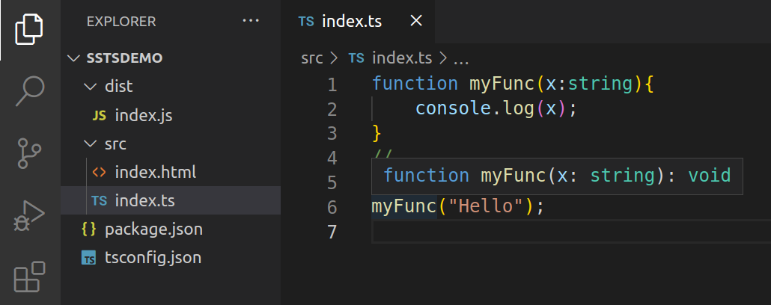
Generics in Action
Notes:
Typical function when I hover over the myFunc keyword the IDE responds with what the function accepts and returns. The information in the red box is NOT part of the code, it is the VSCode intellisence that shows up when I hover my mouse over the myFunc() function call on line 6.

Slide 38
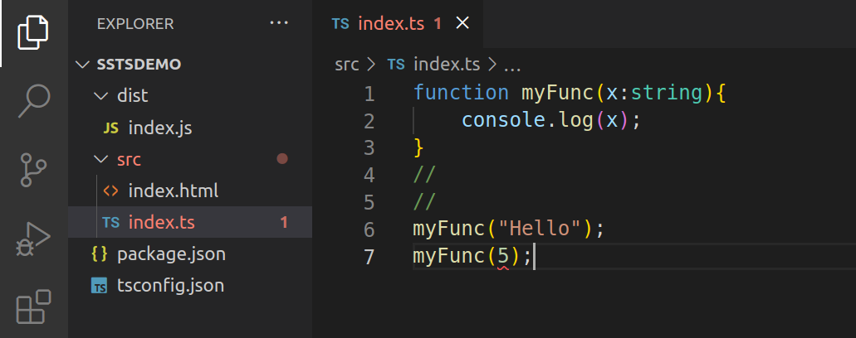
Generics in Action
Notes:
But now if I try this, it wont work, I get the red squiggly, the function accepts a string, and none other

Slide 39
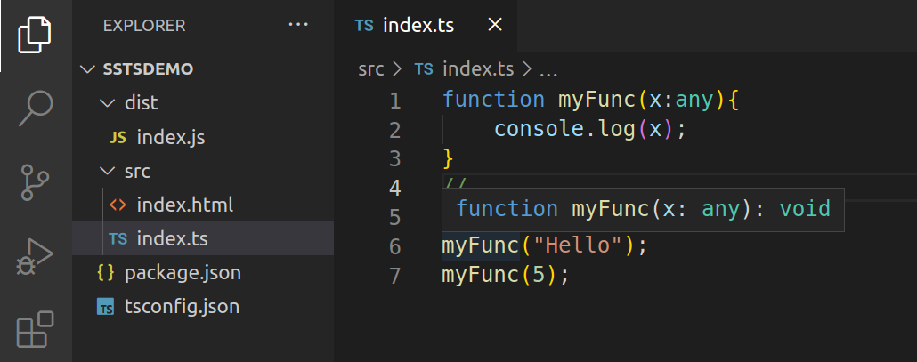
Generics in Action
Notes:
Now I don’t get an error but notice the intelisense when I hover over the myFunct function call again
Any does not tell me much, it means that you can pass any type that TS understands

Slide 40
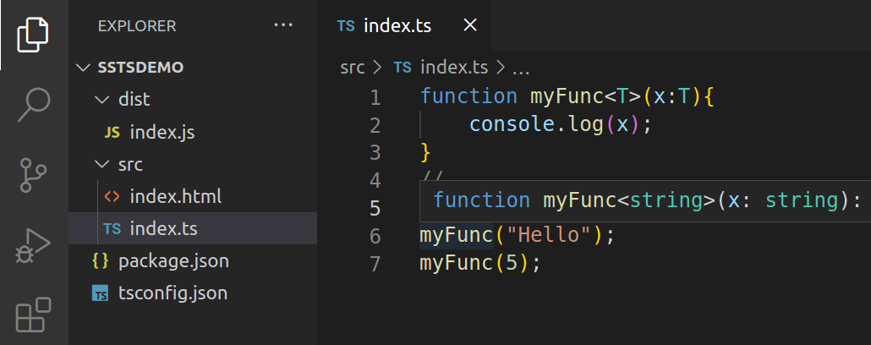
Generics in Action
Notes:
We can improve the function flexibility and type safety by telling the function to use a generic type when it is used
Now if I hover over the first function call on line 6, it says that myFunct accepts a string, …but wait

Slide 41
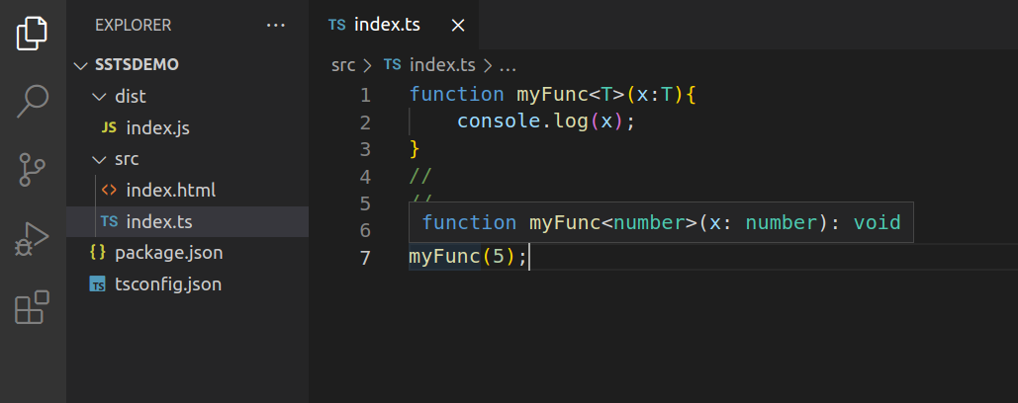
Generics in Action
Notes:
Now if I hover over the second function call on line 7, it says that myFunct accepts a number!
So that means that this function accepts any parameter type that I pass to it!
The point is that once the call is made, the function behaves as though I had hard coded in the actual type at the time that I coded this function

Slide 42
TS is all about Inferences
A JavaScript Object
How TS makes Inferences
TypeScript inference
Notes:
TS inferred that this object is made up of a string an a number. Notice that the TS infereance is NOT a JS Object., notice the semi-colons. This is the Object type in TS, it looks like JS objects but the contents are key – types, NOT key-values

Slide 43
The Object Type
User-defined
types
Notes:
Here is an example of a user-defined type, the type is Employee and it consists of a string and a number primitive type
We can create a specific employee type like this, image 2
Of course we can print out any part of the Employee object after compiling etc.

Slide 44
The Tuple
Tuple is immutable
Notes:
Committees is a Tuple, it is a fixed object. If you hover over the Tuple, you will see that TS simply reports String and Number, basically a union type.
The problem is that TS does not know that it is a Tuple, a strict type. For example we can do this:
employee.committees[2] = 25;
Right now TS does not throw an error bc it only knows that strings and numbers are allowed. So even though TS does infer a type, we want to enforce that this object is number, string string

Slide 45
TypeScript Decorators
Functions that are called by adding an annotation (@) to the members of a class
Not yet fully implemented in TypeScript although extensively used in Angular
Used to add metadata to a class (but can also have use in the DOM)
Cannot be used in inherited classes
Changes may be necessary in the config file, so target must be ES5 or above and experimentalDecoraors key must be set to true
Experimental Topic
Notes:
Graphics:
On each click each line appears
Instructors notes:
Create a union type
Create a function that accepts a parameter of that type
Log the parameter
Pass either parameter, so string or number

Slide 46
TypeScript Decorators
"compilerOptions": {
"target": "es6",
"experimentalDecorators": true
//"module": "commonjs",
}
function Test(){ console.log("Test ran normally..."); } @Test export class wtLossCompetition<T> implements iComp<T>{ competitors: T[] = []; …
Note: at this point we will receive the few arguments error. This is because the function is being used as a decorator, it therefore receives constructor function of the class by default.
Decorators point to functions
Notes:
Make sure the compiler options are in place.
import iComp from "./iCompetable.js";
//
function Test(constructor : Function){
console.log("Test ran normally..." + constructor);
}
//
@Test
export class wtLossCompetition<T> implements iComp<T>{
competitors: T[] = [];
admin: string = "";
backupAdmin : string = "";
addCompetitor(competitor: T): void {
this.competitors.push(competitor);
}
competitonDetails(): string {
return this.competitors.toString();
}
setBackupAdmin(supportAdmin : string){
this.backupAdmin = supportAdmin;
}
competitorDetails(): Array<T> {
return this.competitors;
}
}

Slide 47
TypeScript Decorators
import iComp from "./iCompetable.js";
//
function Test(constructor : Function){
console.log(constructor);
}
//
@Test
export class wtLossCompetition<T> implements iComp<T>{
competitors: T[] = [];
admin: string = "";
backupAdmin : string = "";
…
If you log constructor you will see the entire class as this is what is passed to the constructor of the decorator function by default (when it is used in conjunction with a class)
The entire class is passed to the constructor function
Notes:
The entire class wtLossCompetition gets passed into the Test function, it is the target class. Remember a class is just syntactic sugar over constructer functions in JS.

Slide 48
TypeScript Decorator Factories
To create a decorator factory, simply have the original decorator return a function instead
In this way, we can pass parameters to the function
function Test(){
return function(constructor : Function){
console.log("Decorator factory ran normally..." );
}
}
Also, when we implement this decorator factory function, we must call the function, so:
@Test()
export class wtLossCompetition<T> implements iComp<T>{
competitors: T[] = []; …
Decorator functions can return functions

Slide 49
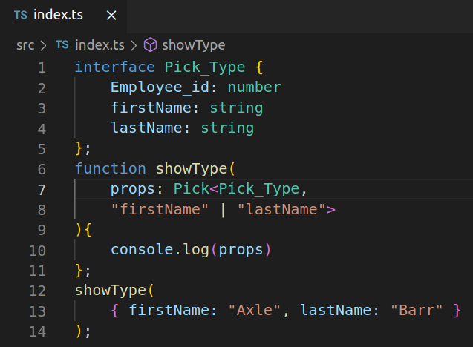
Pick Type
Unusual Types
Notes:
Prints { firstName: 'Axle', lastName: 'Barr' }

Slide 50
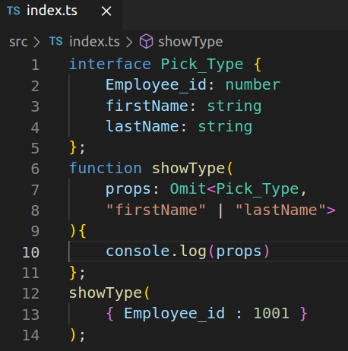
Omit Type
Unusual Types
Notes:
Prints {Employee_id: 1001}

Slide 51
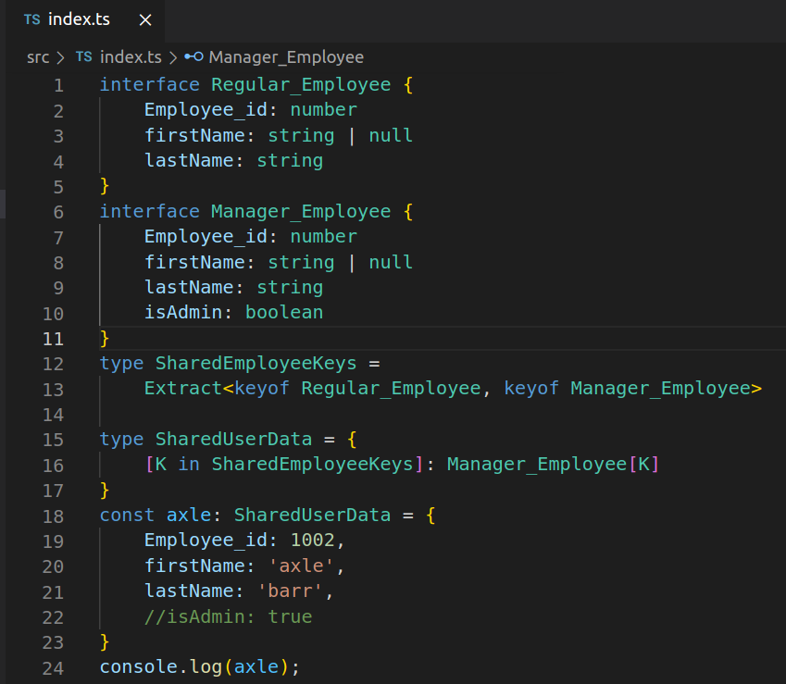
Extract Type
Unusual Types
Notes:
Prints { Employee_id: 1002, firstName: 'axle', lastName: 'barr' }

Slide 52
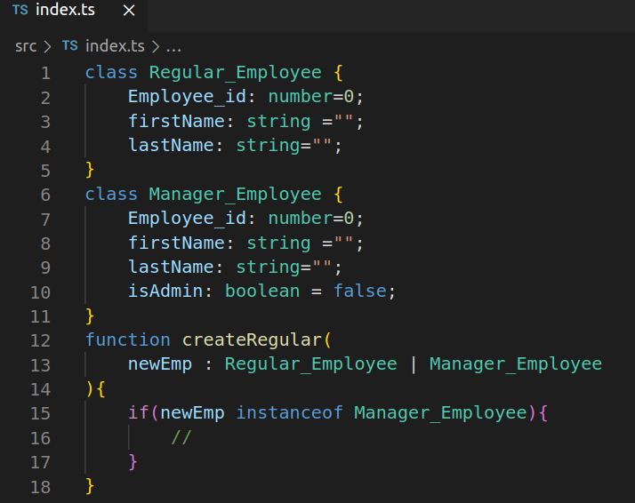
Type Guards - Objects
Unusual Types

Slide 53
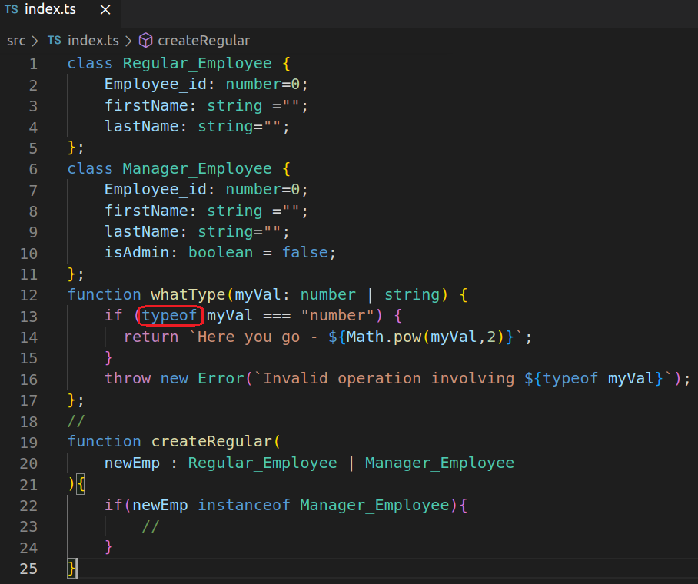
Type Guards - Primitives
Unusual Types

Slide 54
All Types
Intersection Types Union Types Generic Types Utility Types Partial Required Readonly Pick | Omit Extract Exclude Record NonNullable Mapped Types Type Guards Conditional Types
Unusual Types

